Slide 1
Python Programming

Slide 2
Control Structures
Control Structures:
  Sequential
  Decision making (Branching)
  Looping (Iteration)
Decision Making:
  if
  if…else
  Nested if…else
  elif…

Slide 3
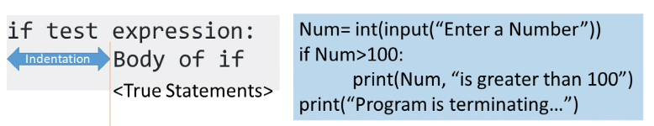
Control Structures (if)
if Statement Syntax:
if test expression:
  if block

Slide 4
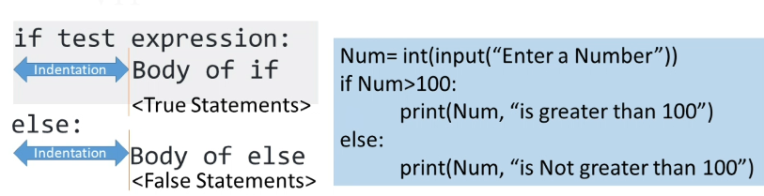
Control Structures (if..else)
if…else Statement Syntax:
if test expression:
  if block
  else:
  else block

Slide 5
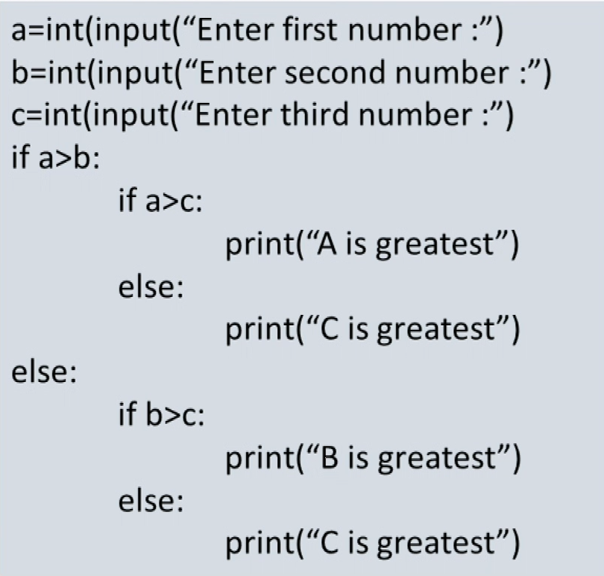
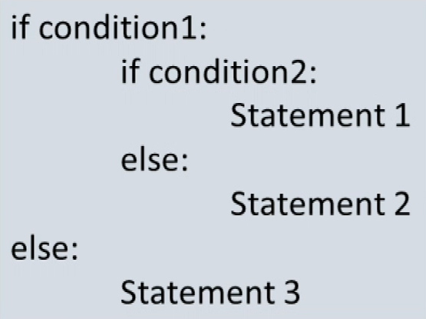
Control Structures (Nested if)

Slide 6
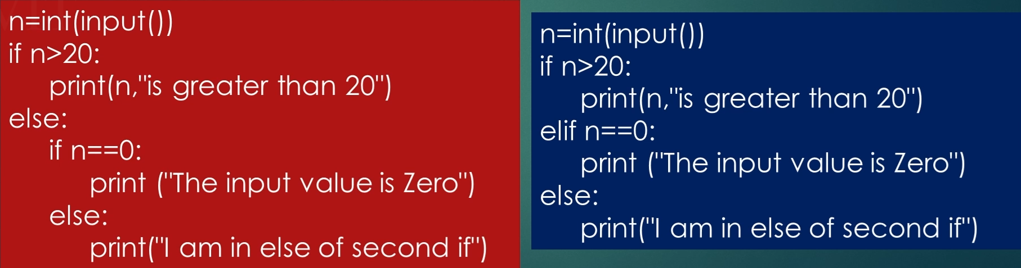
Control Structures (elif)
elif Syntax:
if condition:
if block
elif condition:
elif block

Slide 7
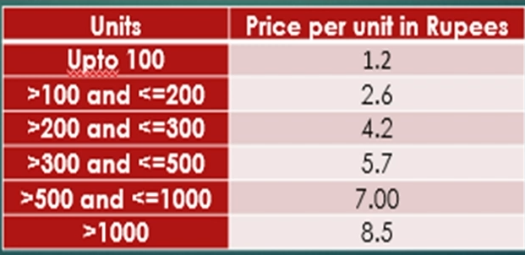
Sample Program

Slide 8
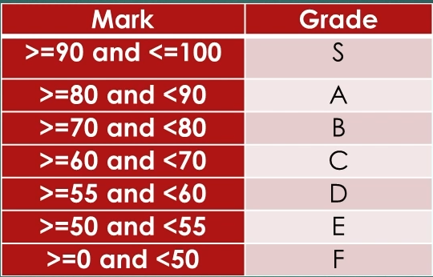
Sample Program

